Slide 1

CS8611- MINI PROJECT VIVA VOCE – APRIL/MAY-2022 EXAMINATIONS
CROP YIELD PREDICTION USING SUPERVISED MACHINE LEARNING TECHNIQUE
BATCH MEMBERS
MANJU D - 513419104026
2. THENDRAL R - 513419104048
GUIDED BY – MR.M.SURESH., M.E.,

Slide 2

  Crop production may be a complicated development that's influenced by Temperature, Humidity, condition input parameters. Agriculture input parameters vary from field to field and farmer to farmer. Collection such info on a bigger space may be a discouraging task. The massive such knowledge sets may be used for predicting their influence on major crops of that individual district or place. Agriculture is associate trade sector that’s benefiting powerfully from the event of detector technology, knowledge science, and machine learning (ML) techniques within the latest years.
CS8611- MINI PROJECT VIVA VOCE – APRIL/MAY-2022 EXAMINATIONS

Slide 3

Among worldwide, agriculture has the major responsibility for improving the economic contribution of the nation.
However, still the most agricultural fields are under developed due to the lack of deployment of ecosystem control technologies.
Due to these problems, the crop production is not improved which affects the agriculture economy.
Hence a development of agricultural productivity is enhanced based on the plant yield prediction. To prevent this problem, Agricultural sectors have to predict the crop from given dataset using machine learning techniques.
CS8611- MINI PROJECT VIVA VOCE – APRIL/MAY-2022 EXAMINATIONS

Slide 4

The analysis of dataset by supervised machine learning technique(SMLT) to capture several information’s like, variable identification, uni-variate analysis, bi-variate and multi-variate analysis, missing value treatments etc.
A comparative study between machine learning algorithms had been carried out in order to determine which algorithm is the most accurate in predicting the best crop.
CS8611- MINI PROJECT VIVA VOCE – APRIL/MAY-2022 EXAMINATIONS

Slide 5

The goal is to develop a machine learning model for Crop yield Prediction, to potentially replace the updatable supervised machine learning classification models by predicting results in the form of best accuracy by comparing supervised algorithm.
CS8611- MINI PROJECT VIVA VOCE – APRIL/MAY-2022 EXAMINATIONS

Slide 6

The scope of this project is to investigate a dataset of crop records for agricultural sector using machine learning technique. To identifying crop predicting by farmer is more difficult. We try to reduce this risk factor behind selection of the crop.
CS8611- MINI PROJECT VIVA VOCE – APRIL/MAY-2022 EXAMINATIONS

Slide 7

Crop cultivation prediction is an integral part of agriculture and is primarily based on factors such as environmental features like rainfall and temperature, and the quantum of fertilizer used, particularly nitrogen and phosphorus.
These factors, however, vary from region to region: consequently, farmers are unable to cultivate similar crops in every region.
Predicting a suitable crop for cultivation is critical to agriculture. In this work, the MRFE, a novel approach, has been proposed for selecting salient features using a permutation crop data set and a ranking method to identify the most suitable crop for a particular region.
CS8611- MINI PROJECT VIVA VOCE – APRIL/MAY-2022 EXAMINATIONS

Slide 8

The Accuracy level obtained is low.
They are not mentioning any metrics reports.
CS8611- MINI PROJECT VIVA VOCE – APRIL/MAY-2022 EXAMINATIONS

Slide 9

The authors NiketaGandhi & Amiya Kumar Tripathi & OwaizPetkar & Liesa J Amstrong has concluded that Support Vector Machines (SVM’s) a supervised machine learning technique. There are number of examples of where it has been used in the agriculture domain. Tripathi reported on how SVM was applied for reduction of precipitation for climate change scenarios to minimize the generalization error bound and to achieve generalized performance. SVM was used to forecast to demand and supply of pulpwood. Hung reported the use of SVM to model urban land use conversion. The study reported a relationship between various factors and rural urban land use. SVM has also been applied for the estimation of crop biophysical parameters with the use of aerial hyper spectral observations.
CS8611- MINI PROJECT VIVA VOCE – APRIL/MAY-2022 EXAMINATIONS

Slide 10
The authors Ramesh Medar & Vijay S. Rajpurohit & Shwetahas concluded that it will review that various applications of machine learning in the former sector and also provides insights into the troubles faced by the farmers and method help in increasing the farmer sector in the countries and apply the more machine learning application. The algorithm used are Artificial Neural Networks, Bayesian belief networks, Decision tree algorithm, clustering regression analysis.
CS8611- MINI PROJECT VIVA VOCE – APRIL/MAY-2022 EXAMINATIONS

Slide 11

The authors Rakesh Kumar, MP Singh, Prabhat Kumar, JP Singhhas concluded that Indian agriculture is highly dependent on summer rainfall. The correlation between summer rainfall and agriculture product production. This paper presents an analysis of crop climate relationship using past crops data. Correlation analysis tells that the monsoon rainfall, Pacific and Indian Ocean sea-surface temperatures and drawing sea-level pressure directly influences the crop prediction in India. Results show that the state-level crop production statistics and sub divisional monsoon rainfall are consistent with all-India result, except few cases.Crop sequencing technique is used to improve net yield rate of crop over season. It uses a method called Crop Selection Method(CSM).
CS8611- MINI PROJECT VIVA VOCE – APRIL/MAY-2022 EXAMINATIONS

Slide 12

  The algorithm developed introduces a data-driven model to predict and forecast crop yield using joint dependencies of Weather and climate features. Although there are several techniques existing to obtain rainfall predictions, the algorithm discussed in this paper succeeded in emphasizing on Rainfall along with the crop yield prediction. This designed model took into account the most relevant environment as well as soil parameters that affect the crop growth, in a way that each of those parameters received equal weight in the final prediction. The outcomes of this research can benefit the agriculturists/farmers by knowing the investment capital on the crop to be sown, even before the sowing season begins Naive Bayes is used for the large dataset can also be beneficial. Use of naïve Bayes and decision tree makes the model very efficient in terms of computation. The system is scalable as it can be used to test on different crops.
CS8611- MINI PROJECT VIVA VOCE – APRIL/MAY-2022 EXAMINATIONS

Slide 13

Exploratory Data Analysis:
Multiple datasets from different sources would be combined to form a generalized dataset, and then different machine learning algorithms would be applied to extract patterns and to obtain results with maximum accuracy.
Training the Dataset:
For example, to import any algorithm and train_test_split class from sklearn and numpy module for use in this program.
CS8611- MINI PROJECT VIVA VOCE – APRIL/MAY-2022 EXAMINATIONS

Slide 14
Then we encapsulate load_data() method in data_dataset variable. Further we divide the dataset into training data and test data using train_test_split method. The X prefix in variable denotes the feature values and y prefix denotes target values.
Testing the Dataset:
So the predicted target value comes out to be 0. Finally we find the test score which is the ratio of no. of predictions found correct and total predictions made. We do this using the score method which basically compares the actual values of the test set with the predicted values.
CS8611- MINI PROJECT VIVA VOCE – APRIL/MAY-2022 EXAMINATIONS

Slide 15

It is done better than their competitors but there is no article or public mention of their work being used practically to assist the farmers. If there are some genuine problems in rolling out that work to next stage, then identify those problems and try solving them.
It is targeted to those farmers who wish to professionally manage their farm by planning, monitoring and analysing all farming activities.
It is targeted to get predicted crop from crop yield and product price.
CS8611- MINI PROJECT VIVA VOCE – APRIL/MAY-2022 EXAMINATIONS

Slide 16






PEOPLE
INPUT INFORMATION
DATASET
AGRI DATA
PREPROCESSING
PREDICTION
IMPLEMENTING ALGORITHM
VISUALIZATION
CS8611- MINI PROJECT VIVA VOCE – APRIL/MAY-2022 EXAMINATIONS

Slide 17

1. Software Requirements:
Operating System : Windows / Linux
Tool : Anaconda with Jupyter Notebook
2. Hardware requirements:
Processor : Pentium IV/III
Hard disk : minimum 80 GB
RAM : minimum 2 GB
CS8611- MINI PROJECT VIVA VOCE – APRIL/MAY-2022 EXAMINATIONS

Slide 18

Data Pre-processing
Data Validation/Cleaning/Preparing Process
Data Analysis of Visualization
Implementing Algorithm
Deployment Using GUI
CS8611- MINI PROJECT VIVA VOCE – APRIL/MAY-2022 EXAMINATIONS

Slide 19

Data Pre-processing
Validation techniques in machine learning are used to get the error rate of the Machine Learning (ML) model, which can be considered as close to the true error rate of the dataset.
If the data volume is large enough to be representative of the population, you may not need the validation techniques. However, in real-world scenarios, to work with samples of data that may not be a true representative of the population of given dataset. To finding the missing value, duplicate value and description of data type whether it is float variable or integer.
The sample of data used to provide an unbiased evaluation of a model fit on the training dataset while tuning model hyper parameters.
CS8611- MINI PROJECT VIVA VOCE – APRIL/MAY-2022 EXAMINATIONS

Slide 20

Data Validation/ Cleaning/Preparing Process:
Importing the library packages with loading given dataset. To analyzing the variable identification by data shape, data type and evaluating the missing values, duplicate values.
A validation dataset is a sample of data held back from training your model that is used to give an estimate of model skill while tuning model's and procedures that you can use to make the best use of validation and test datasets when evaluating your models.
Data cleaning / preparing by rename the given dataset and drop the column etc.
CS8611- MINI PROJECT VIVA VOCE – APRIL/MAY-2022 EXAMINATIONS

Slide 21
Exploration data analysis of visualization:
Data visualization is an important skill in applied statistics and machine learning.
Statistics does indeed focus on quantitative descriptions and estimations of data.
Data visualization provides an important suite of tools for gaining a qualitative understanding.
This can be helpful when exploring and getting to know a dataset and can help with identifying patterns, corrupt data, outliers, and much more.
CS8611- MINI PROJECT VIVA VOCE – APRIL/MAY-2022 EXAMINATIONS

Slide 22
Implementing Algorithm:
It is important to compare the performance of multiple different machine learning algorithms consistently and it will discover to create a test harness to compare multiple different machine learning algorithms in Python with scikit-learn.
It can use this test harness as a template on your own machine learning problems and add more and different algorithms to compare.
Each model will have different performance characteristics. Using resampling methods like cross validation, you can get an estimate for how accurate each model may be on unseen data.
CS8611- MINI PROJECT VIVA VOCE – APRIL/MAY-2022 EXAMINATIONS

Slide 23
Deployment GUI:
Developing desktop based applications with python Tkinter is not a complex task. An empty Tkinter top-level window can be created by using the following steps.Tkinter is a python library for developing GUI (Graphical User Interfaces).
We use the tkinter interface and Tkinter will come with Python as a standard package, it can be used for security purpose of each users or accountants. There will be two kinds of pages like registration user purpose and login entry purpose of library for creating an application of UI (User Interface), to create windows and all other graphical user users.
CS8611- MINI PROJECT VIVA VOCE – APRIL/MAY-2022 EXAMINATIONS

Slide 24

Accuracy of the crop yield and product price.
Prediction of crop based on the Accuracy found.
Taken Season as one of the parameters for calculating accuracy.
CS8611- MINI PROJECT VIVA VOCE – APRIL/MAY-2022 EXAMINATIONS

Slide 25

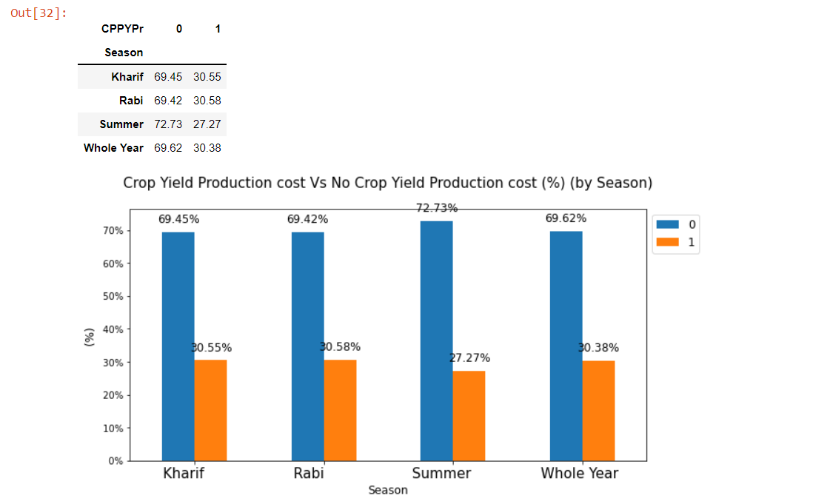
CS8611- MINI PROJECT VIVA VOCE – APRIL/MAY-2022 EXAMINATIONS

Slide 26
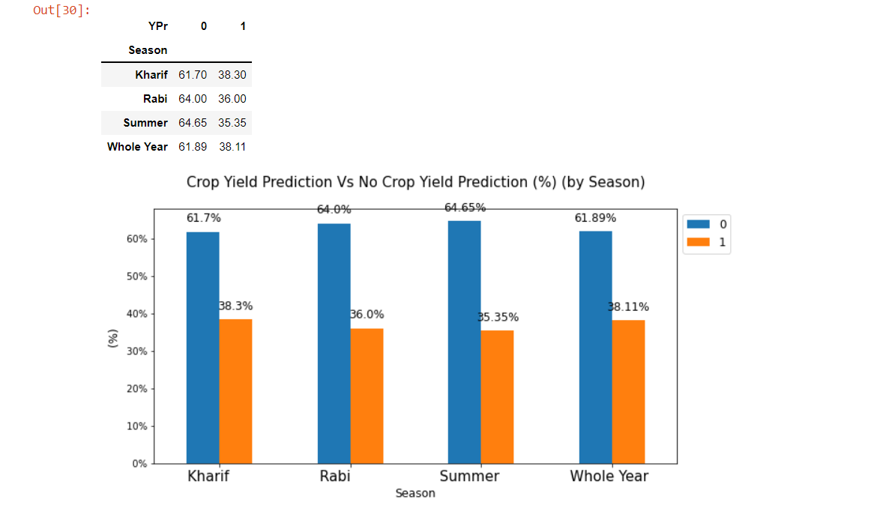
CS8611- MINI PROJECT VIVA VOCE – APRIL/MAY-2022 EXAMINATIONS

Slide 27

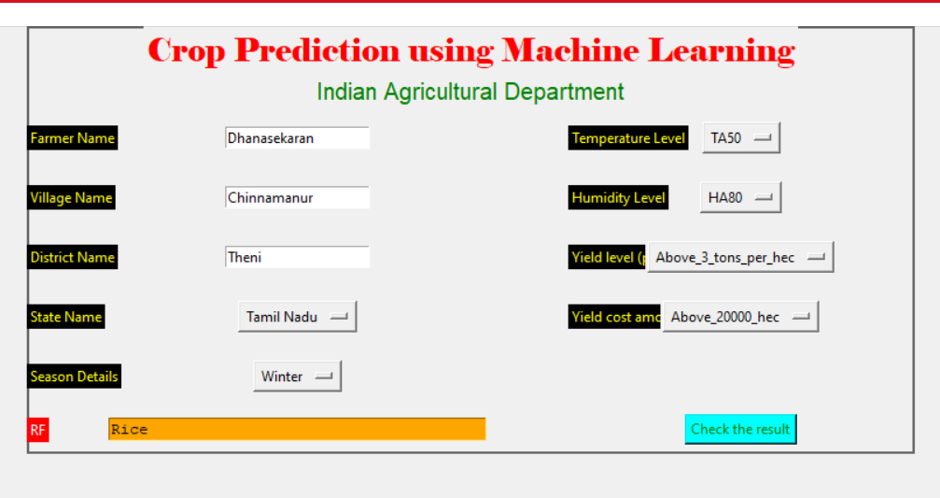
CS8611- MINI PROJECT VIVA VOCE – APRIL/MAY-2022 EXAMINATIONS

Slide 28

The analytical process started from data cleaning and processing, missing value, exploratory analysis and finally model building and evaluation. Finally we predict the crop using machine learning algorithm with different results. This brings some of the following insights about crop prediction. As maximum types of crops will be covered under this system, farmer may get to know about the crop which may never have been cultivated and lists out all possible crops, it helps the farmer in decision making of which crop to cultivate. Also, this system takes into consideration the past production of data which will help the farmer get insight into the demand and the cost of various crops in market.
CS8611- MINI PROJECT VIVA VOCE – APRIL/MAY-2022 EXAMINATIONS

Slide 29

Remaining SMLT algorithms will be involve to finding the best accuracy with applying to predict the crop yield and cost (real time).
Agricultural department wants to automate the detecting the yield crops from eligibility process.
For more accuracy, Datasets of Soil can be included.
CS8611- MINI PROJECT VIVA VOCE – APRIL/MAY-2022 EXAMINATIONS

Slide 30

Niketa Gandhi, OwaizPetkar, Leisa J Armstrong “Rice crop yield prediction using Support Vector Machines” 2016 IEEE Technological Innovations in ICT for Agriculture and Rural Development
J.P. Singh, M.P. Singh, Rakesh Kumar and Prabhat Kumar “Crop Selection Method to Maximize Crop Yield Rate using Machine Learning Technique”, International Journal on Engineering Technology, May 2015.
Prof. D. S. Zingade, OmkarBuchade, NileshMehra, ShubhamGhodekar, ChandanMehta “Crop Prediction system using machine Learning”.
Ramesh Medar, Vijay S.Rajpurohit, Shweta “Crop yield Prediction using Machine Learning Techniques” 2019 IEEE 5th InternationalConference for Convergence in Technology(I2CT)
CS8611- MINI PROJECT VIVA VOCE – APRIL/MAY-2022 EXAMINATIONS

